Slide 1
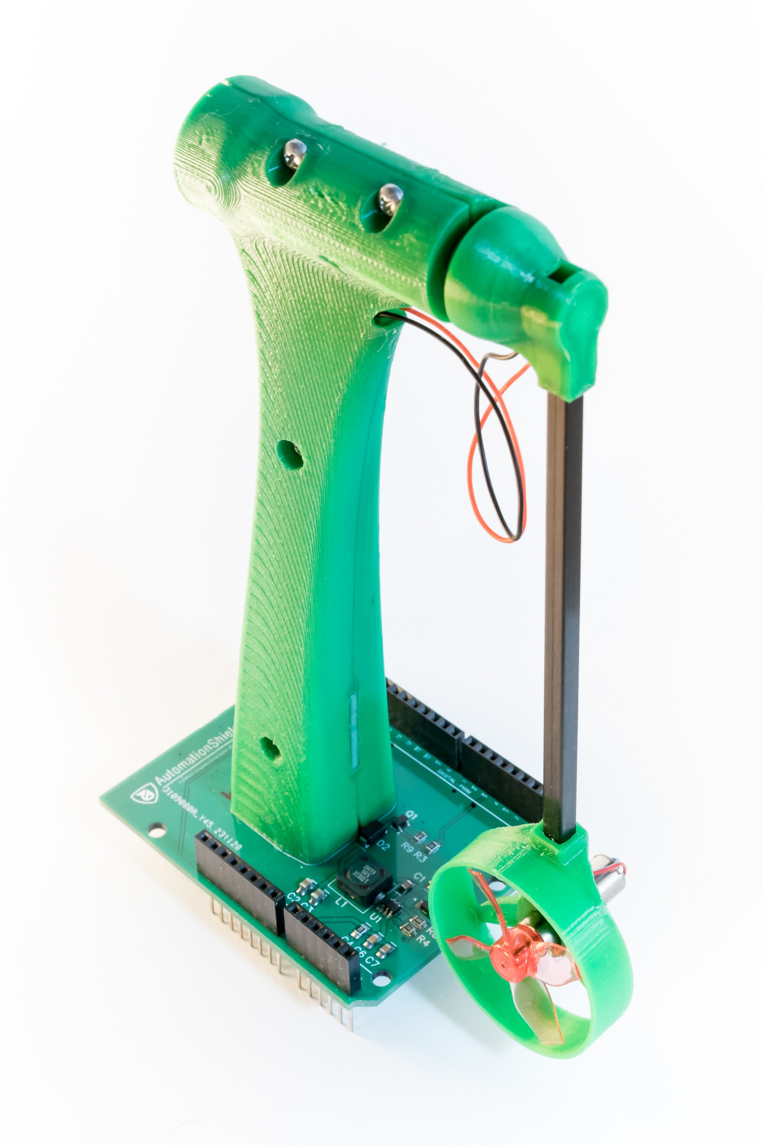
Control System Synthesis
Diploma Project 1
Author: Bc. Radovan Jakubčík
Supervisor: Ing. Marián Tárník, PhD.

Slide 2
Content
Introduction
System Analysis
System Modeling
Frictions
System Representations
Observability and Controllability
Controller Design
Future Work
Conclusion

Slide 3
Introduction
Analyze the system
Model the system
Feasible control method
Simulate system with control method
Practical aspects of hardware implementation

Slide 4
System Analysis
Test

Slide 5
Engagement data
Area | Impact on engagement | Source
Eye contact | 80% more audience connection | Business review
Storytelling | Increases retention by 22x | University study
Interactive polls | Leads to 34% higher engagement | LinkedIn
Visual aids | Boosts retention by 65% | Company research
Attention spans | Lasts about 5 minutes | Journal article
First impressions | Made in the first 15 seconds | Industry report

Slide 6

Visual appeal
Studies show that 35% of an audience’s retention rate is attributed to visuals, so use these best practices.
Use high-quality images
Avoid stock photos that feel overused. Use animated images sparingly. Motion should enhance, not distract.
Leverage infographics
Present complex data in an easy-to-digest format.
Keep text minimal
Slides should support your speech, not replace it.
Use brand colors
Maintain consistency in fonts and color palettes for professionalism.

Slide 7

Effective delivery techniques
Your delivery can make or break your presentation. Focus on the following techniques.
Voice modulation
Vary pitch, tone, and volume to emphasize key points. Pause strategically as silence builds anticipation.
Body language
Maintain open gestures and avoid crossing your arms. Move naturally. Step forward when making a strong point.
Non-verbal cues
Look for cues (like nodding and note-taking) that show that your audience is engaged.
Additional tips
Be confident, rehearse aloud, and show enthusiasm.

Slide 8
Delivering with confidence
Meaningful eye contact, purposeful gestures, and good posture can enhance your message and make it more memorable.

Slide 9

Q & A
Use this portion of your presentation to answer audience questions.

